Slide 1
Hydrological Status and Outlook System
Agenda item: 3.3.3 HydroSOS
RA VI-19 session
15-16 October, 2024
Presented by WMO secretariat

Slide 2
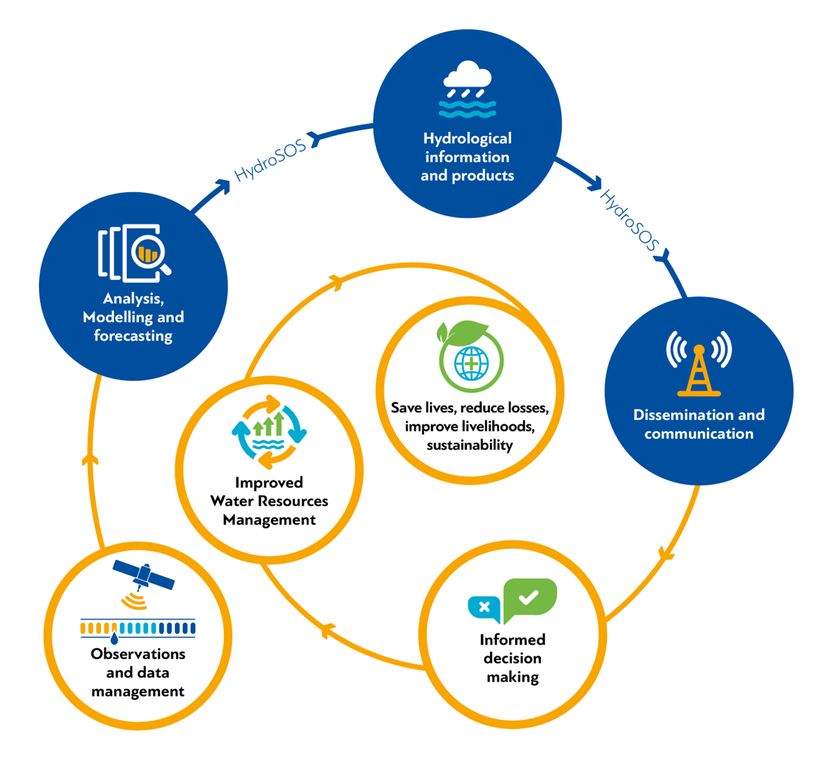
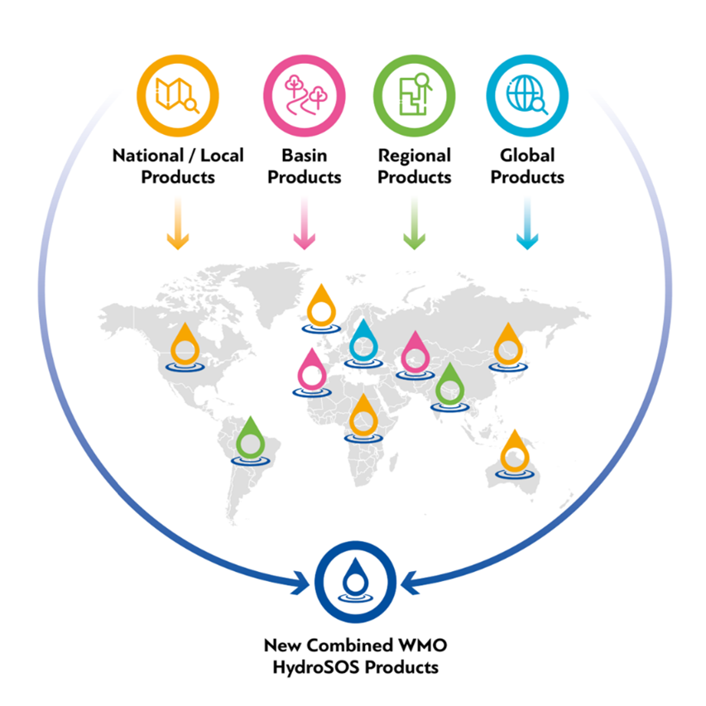
What is HydroSOS and what it provides?
HydroSOS is the link between monitoring and decision making

Slide 3
Brief timeline
Dec. 2016
The 15th Session of the WMO Commission for Hydrology (CHy) approves the pilot for HydroSOS.
Sep. 2017
The HydroSOS Initial Planning Meeting is held, thus starting HydroSOS Pilot phase.
June 2019
Cg-18 recognizes the HydroSOS initiative as a fundamental component of the WMO Strategic Plan (Resolution 25). HydroSOS supports the eight Long-Term Ambitions.
2020–2021
WMO Regional Associations task their Hydrological Bodies to "develop a regional implementation plan for HydroSOS".
Oct. 2021
The Extraordinary World Meteorological Congress confirms end of the HydroSOS pilot phase and requests to move on to implementation.
May 2023
The World Meteorological Congress 19 (Cg-19) endorses HydroSOS Regional Implementation Plans.
2024
HydroSOS is being implemented in several countries (>60) at different pace.

Slide 4
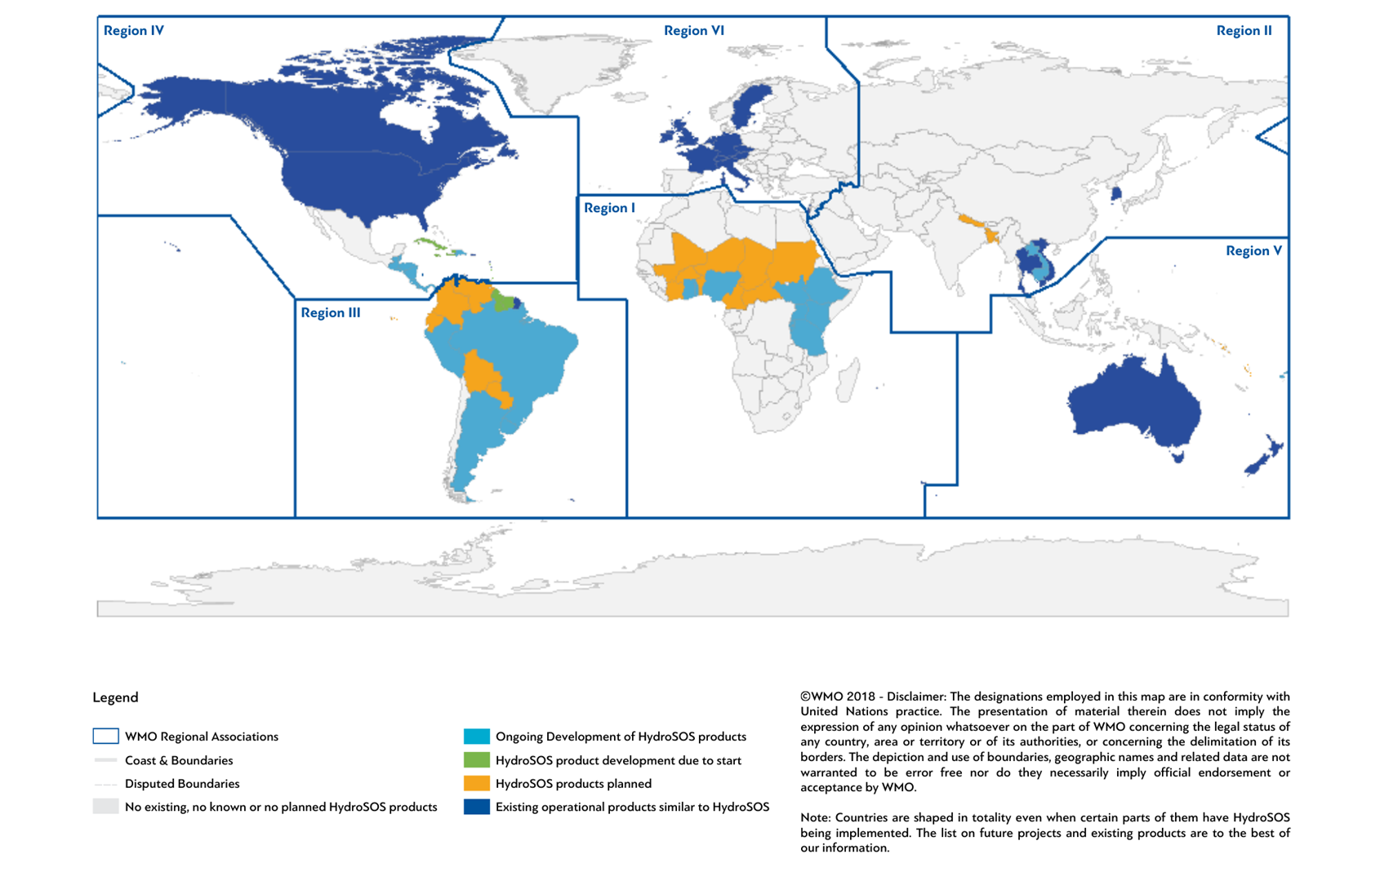
HydroSOS Structure and implementation
Implementation
Technical Development
Status and Outlooks
Coordination and Support
Global
Regional (WMO Regions)
Projects (Transboundary /National / Basin)

Slide 5
RA VI-19 Doc 3.3.3 – HydroSOS (DECISION)
Purpose
• Accelerate the implementation of the Hydrological Status and Outlook System (HydroSOS) within RA VI to provide actionable water resource information to stakeholders across sectors.
• Oversee and coordinate the regional implementation plan through the RA VI Coordination Panel for Hydrology, addressing priorities and gaps identified by the WMO Hydro and HydroSOS surveys.
Importance
• Strengthens national and transboundary prediction capacities, harmonizing products/indicators on regional and global scales.
• Promotes collaboration between national focal points and the RA VI Coordination Panel for Hydrology for effective implementation of HydroSOS.
• Supports capacity development efforts, ensuring consistent implementation of HydroSOS to improve decision-making and risk management for sectors like agriculture, energy, and water management.

Slide 6
RA VI-19 Doc 3.3.3 – HydroSOS (DECISION)
Invites Members:
(1) To implement HydroSOS within the RA VI region to provide critical, actionable water resources information to stakeholders across various sectors, including agriculture, energy, transportation, and water management agencies;
(2) To strengthen national and transboundary nowcasting and forecasting capacities (including seasonal and sub-seasonal timescale), harmonizing existing products at regional and global scales through the HydroSOS initiative;
(3) To nominate or reconfirm national focal points on HydroSOS with whom the Regional Association VI Coordination Panel for Hydrology could collaborate as needed to facilitate effective communication, coordination, and implementation of HydroSOS activities within each Member;
(4) To support capacity-development efforts (not limited to RA VI) to ensure consistent and effective implementation of HydroSOS at global, regional, and national levels, benefiting various sectors and stakeholders.

